Slide 1
C R E A T I V E L E A R N I N G + W E A R A B L E T E C H N O L O G Y BECCA ROSE GLOWACKI twitter: @beccaerose website: www.beccarose.co.uk
Notes:
Interactive fashion accessories
Aim of this slide show is to give a bit of background, some context of what people are doing, and some inspiration for future development –made by you!

Slide 2
Greetings!
Notes:
Start with the greetings game

Slide 3
Overview This session is about design, technology, and creative learning. We will cover: Creative learning Wearable Technology Ideation + Making Through lecture, discussion, play, and making

Slide 4
Workshop plan
10:00 E-textiles
Introduction to e-textiles through making an accessory to wear at the conference
??:00 Break / Lunch
??:00 Projects and process
Introduction to larger project ideas through quick prototypes
Notes:
Write down time table of what we are going to do:
Intro
Making and Play
Lunch
Human breadboards + project ideas (what I have done, and discussion about what you could do)

Slide 5
Some context…

Slide 6
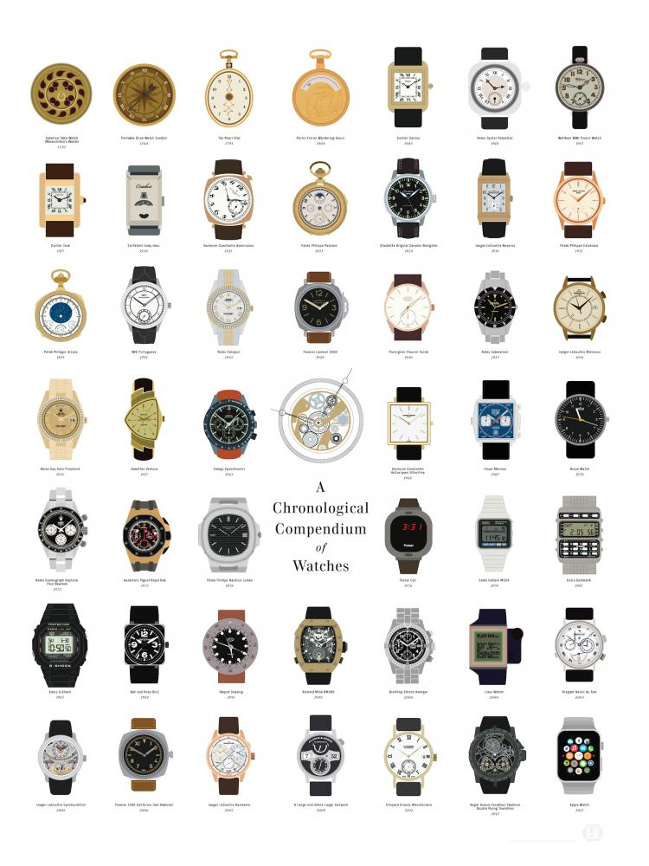
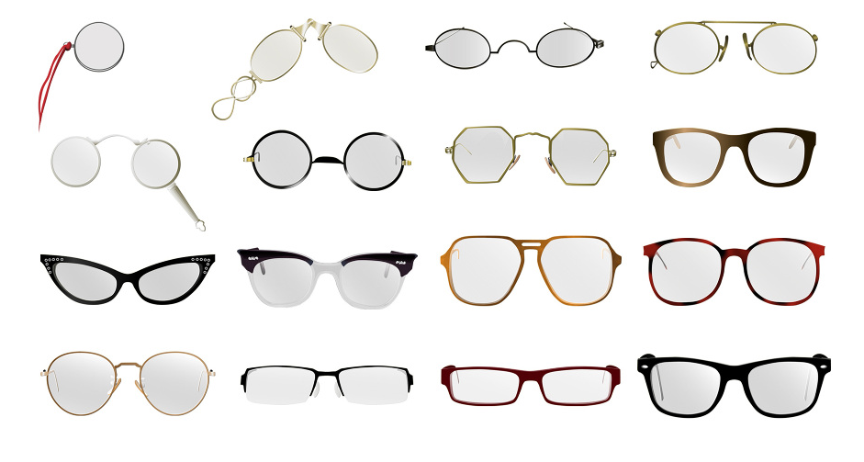
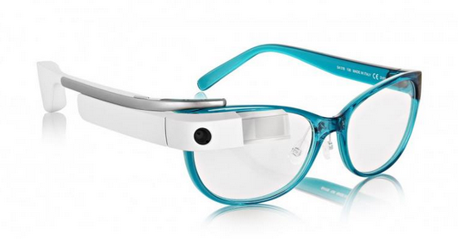
Wearable technology has a long history….
Notes:
Wearable technology –developed to improve our lives
Also a fashion statement
Who know what will happen to the google glass (or VR...)

Slide 7
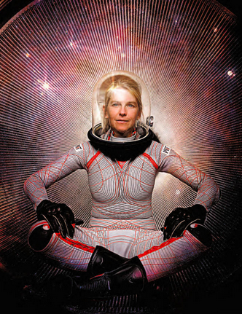
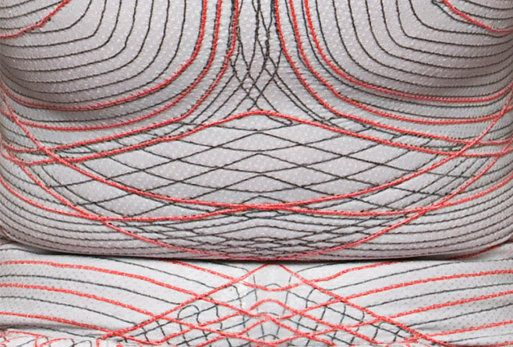
Development of materails by nasa and other places
Developments of “smart” fabrics through NASA and industry
Dava Newman, MIT
Notes:
What happens when you bring smart materials into the hands of creative inventors?
–developed by NASA in this case for pressure, and other industrial uses like shielding from Electromagnet Fields or packaging for electronic components.
This suit by Dava Newman, MIT

Slide 8
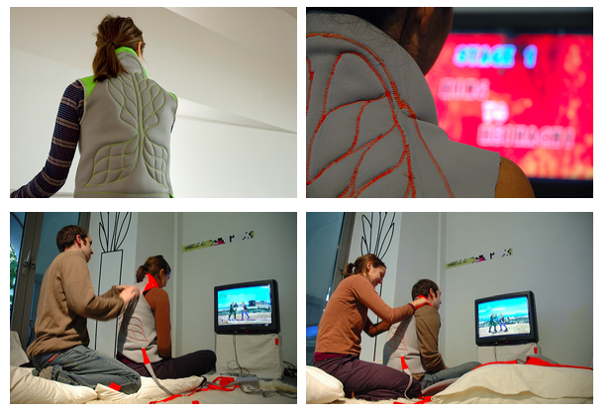
Project 1 massage hannahs
Artists exploring what is possible with the new materials
Massage Me by Kobakant, 2007 (http://www.massage-me.at)
Notes:
Community based open sourse practice
smart materials + Control +Sensors + human centered design
Massage me
Making of:
/?menu=1

Slide 9
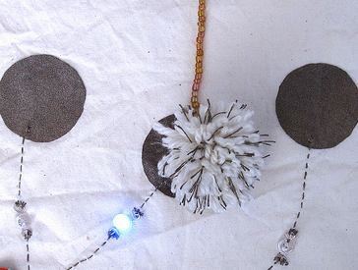
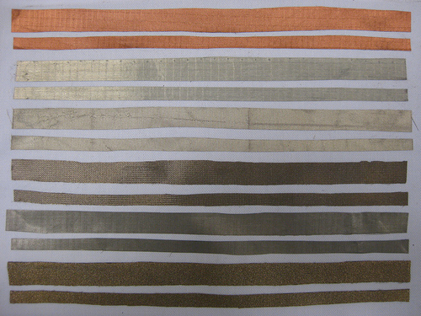
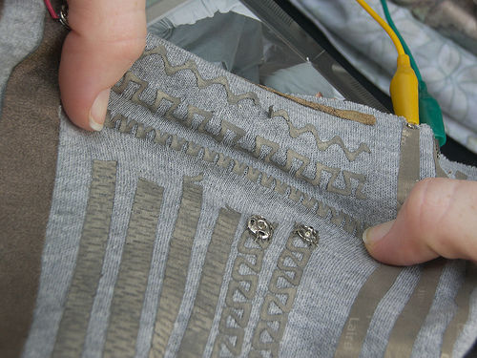
Making industrial materials available to buy in hobby quantities
materials now accessible can be used by designers, makers and DIY level –not just in industry
Notes:
These materials now accessible can be used by designers, makers and DIY level –not just in industry

Slide 10
So what? What are teachers and learners excited about?

Slide 11
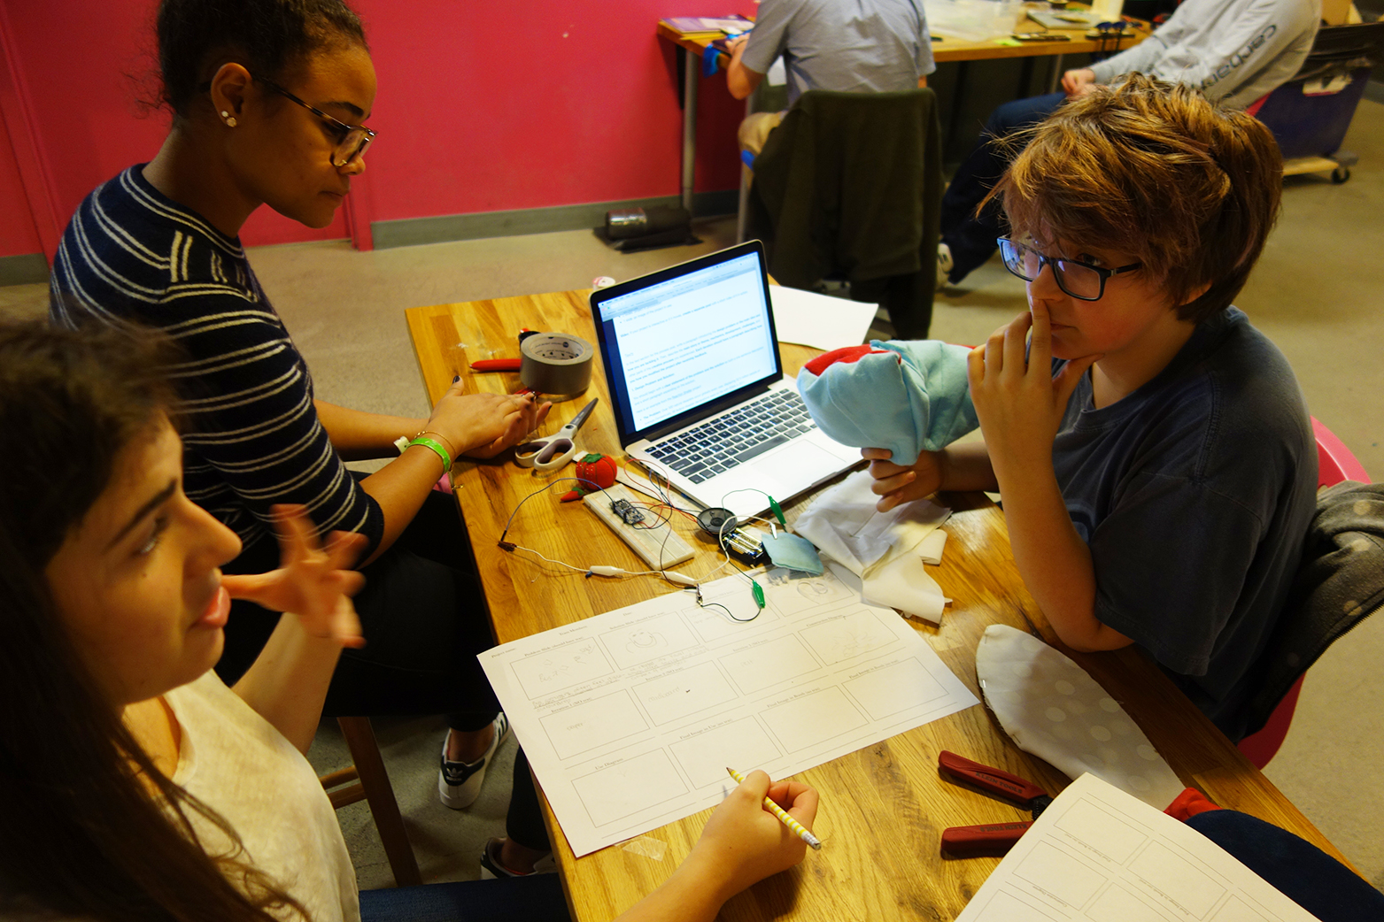
“normally in physics class I will do anything to avoid Arduino and all that technical stuff, but I would actually do it now that I know how to create something new”
NuVu Student, 2015

Slide 12
Design and technology that is…. ”….not simply focused on preparing future technologists but rather technology capable critical thinkers" Leo Elshof (2009). from Toward sustainable practices in technology education. International Journal of Technology and Design Education, 19(2), 133-147.
Notes:
Education for sustainable futures

Slide 13
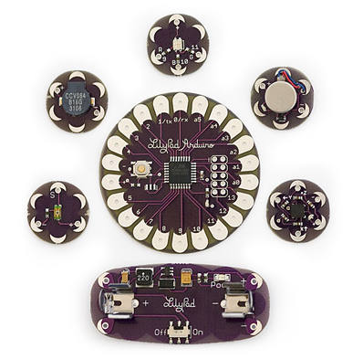
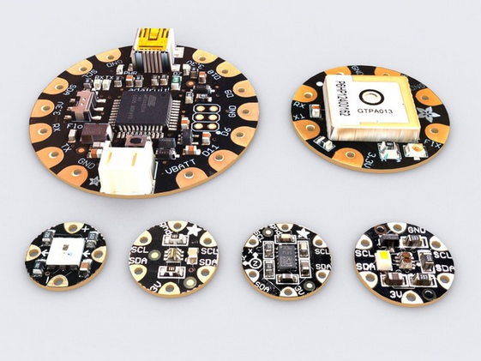
Programming:
Flora and Lilypad are Arduinos designed to be embedded into wearable projects

Slide 14
E-textile circuits

Slide 15
Batteries
Conductive thread
battery holders
Sewing equipment and materials
Notes:
Materials we use

Slide 16
Simple cicuit –make one with crocodile clips
Notes:
Simple cicuit –make one with crocodile clips

Slide 17
Circuit with a switch
Notes:
Circuit with a switch

Slide 18
Designing your accessory
4 x Design ideas
Notes:
Follow up from the greetings game, thinking about expressing something about you, and design conference garb

Slide 19
Simple circuit
Advanced circuit
Choose a circuit depending on your experience

Slide 20
Break

Slide 21
Lunch

Slide 22
Projects and process
Notes:
Go into detail about learning though making with wearble tech
Bio fashion
Interactive accessories
Wearble tech

Slide 23
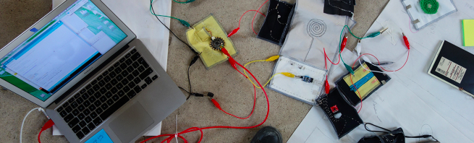
Human Breadboards Research
Questions: What do we learn when we are leaning with reference to people, the body, the space around us? How do you go beyond the swatch? How do you build wearable tech in to the curriculum in a meaningful and critical way? How to focus on process and learning, and not the product? http://blog.beccarose.co.uk/2015/09/08/human-breadboards/

Slide 24
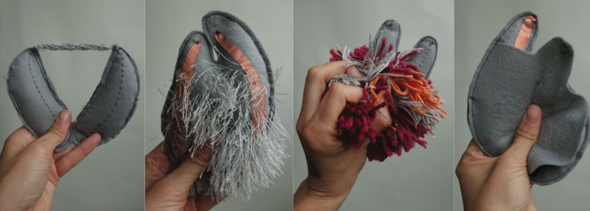
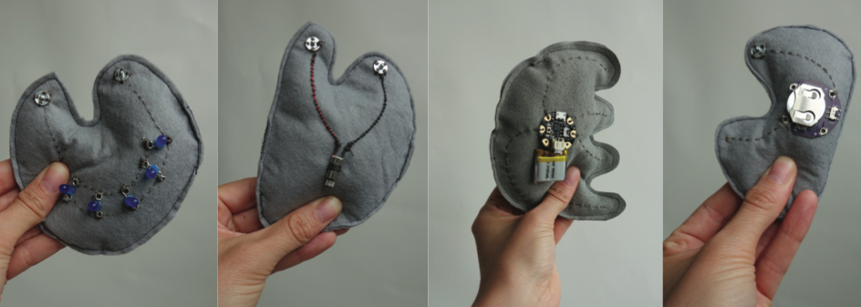

Slide 25
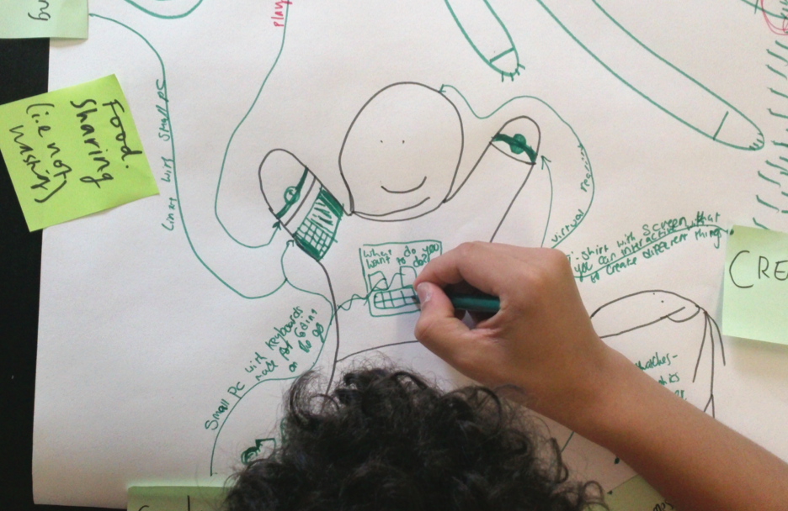

Slide 26
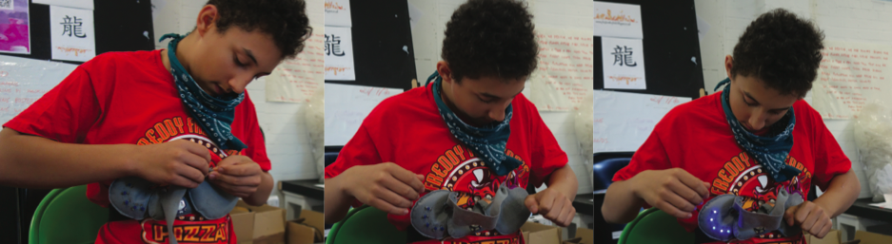

Slide 27
Problem or question
Development
Development
Research
Notes:
Development

Slide 28
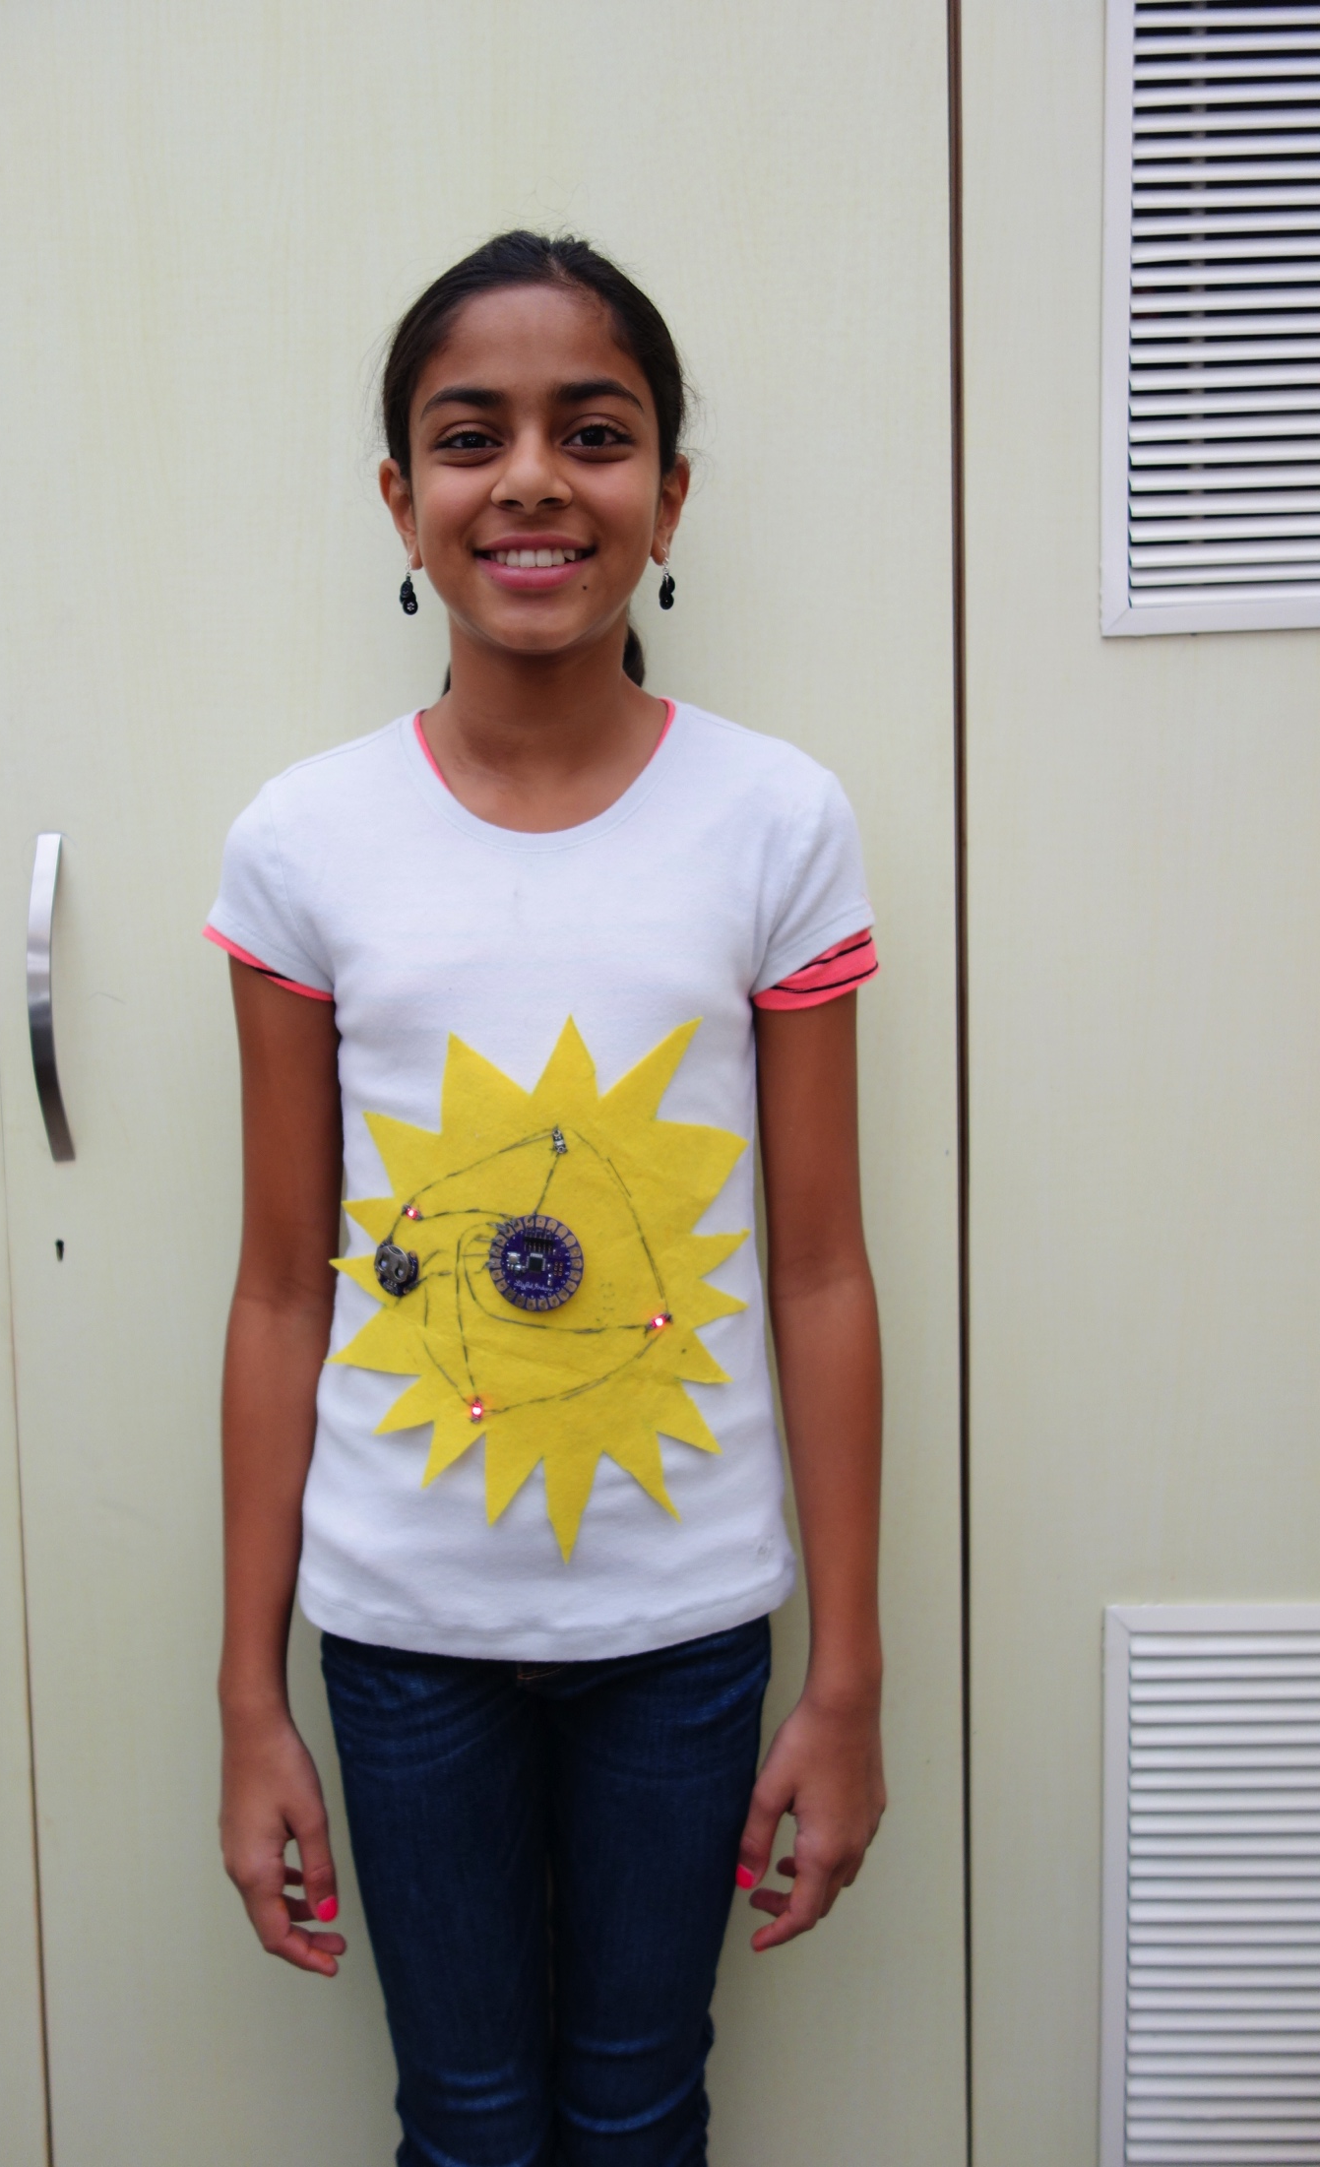
Interactive Accessories: technology + making ASB, 2015

Slide 29
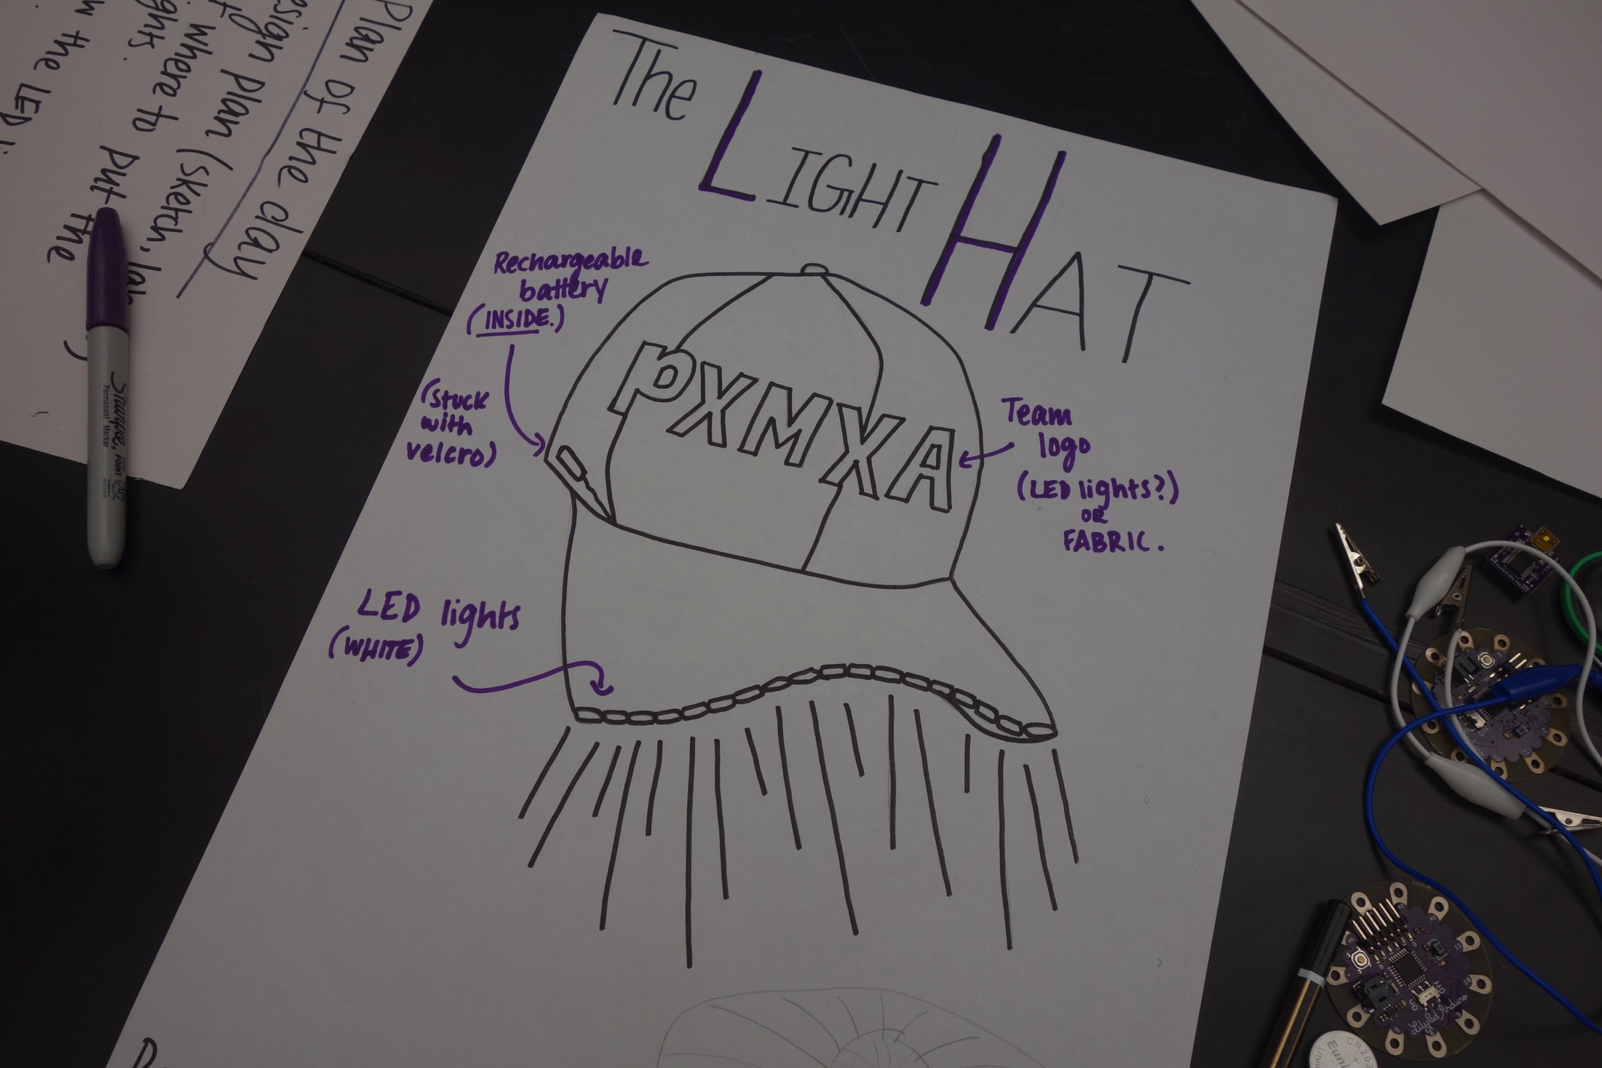

Slide 30
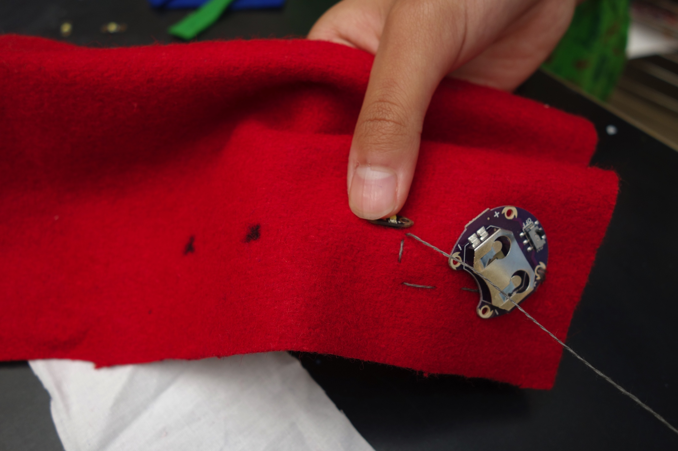

Slide 31
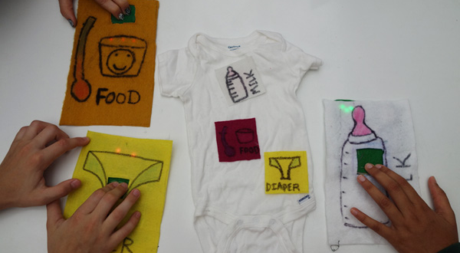
Communicational Onsie
Notes:
Show slides before circuit
Complex ideas (learning through visual / touch not just language
Social problem

Slide 32
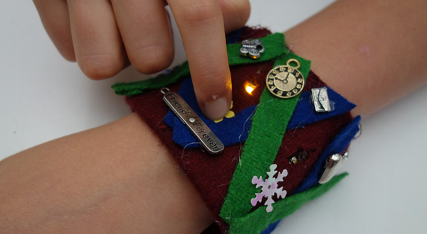
Friendship Memory Cuff
Notes:
Weakest group in terms of language –tutors were worried, short circuited and had to re-wire several times, but made a beautiful and interesting project
--complex circuit system

Slide 33
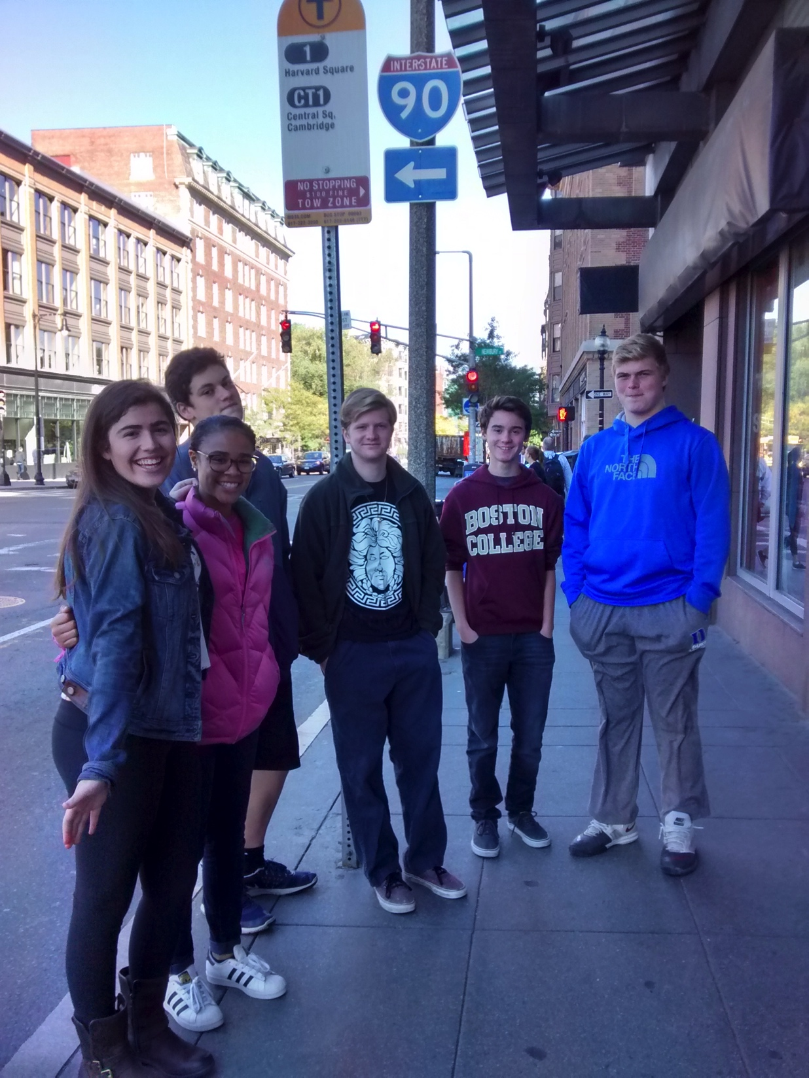
Interactive Bus: technology + storytelling NuVu, 2016

Slide 34
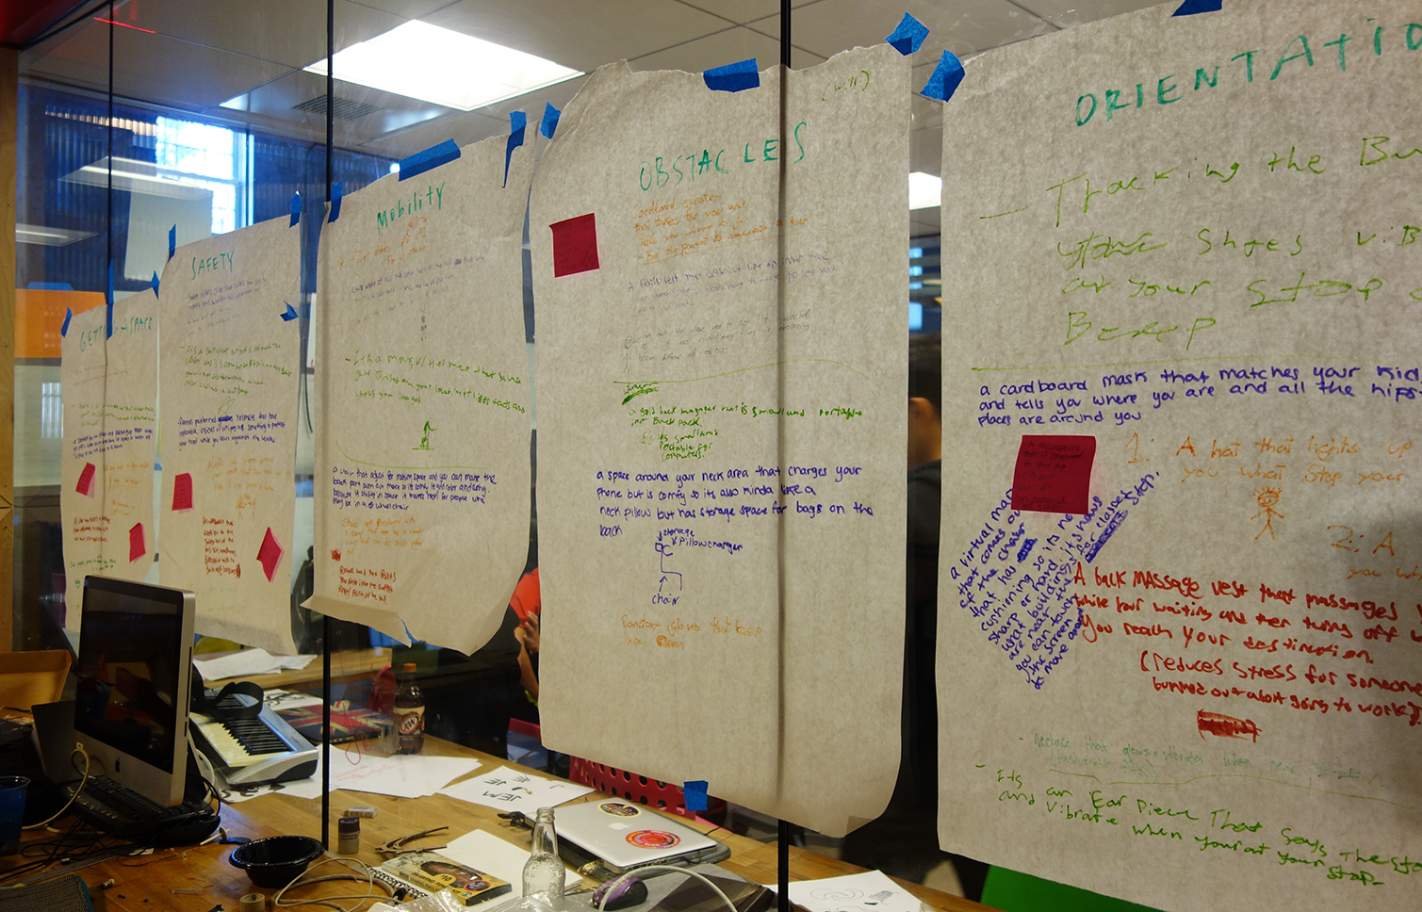
Initial Research Site visits, documentation, role play, photos
Notes:
Interesting that this was the most fascinating of all the write ups they made –they really responded creatively to the experience.

Slide 35
Development discussion, further research, rapid prototyping

Slide 36
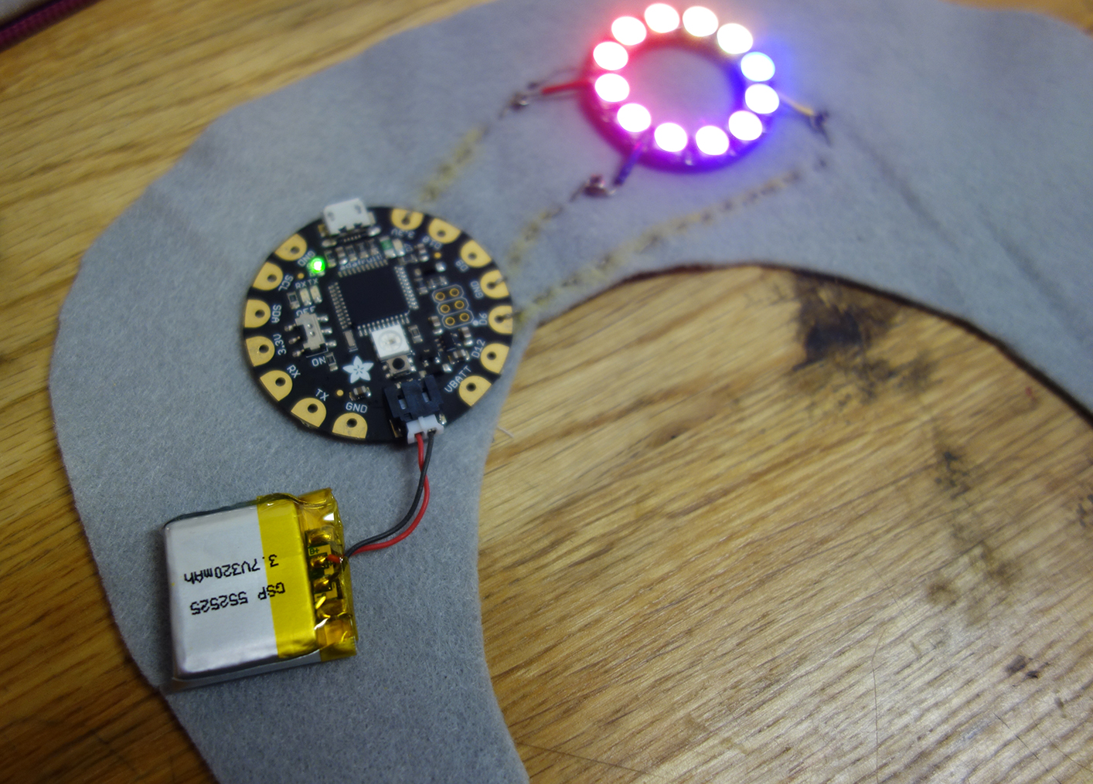
Prototypes and iteration

Slide 37

Development

Slide 38
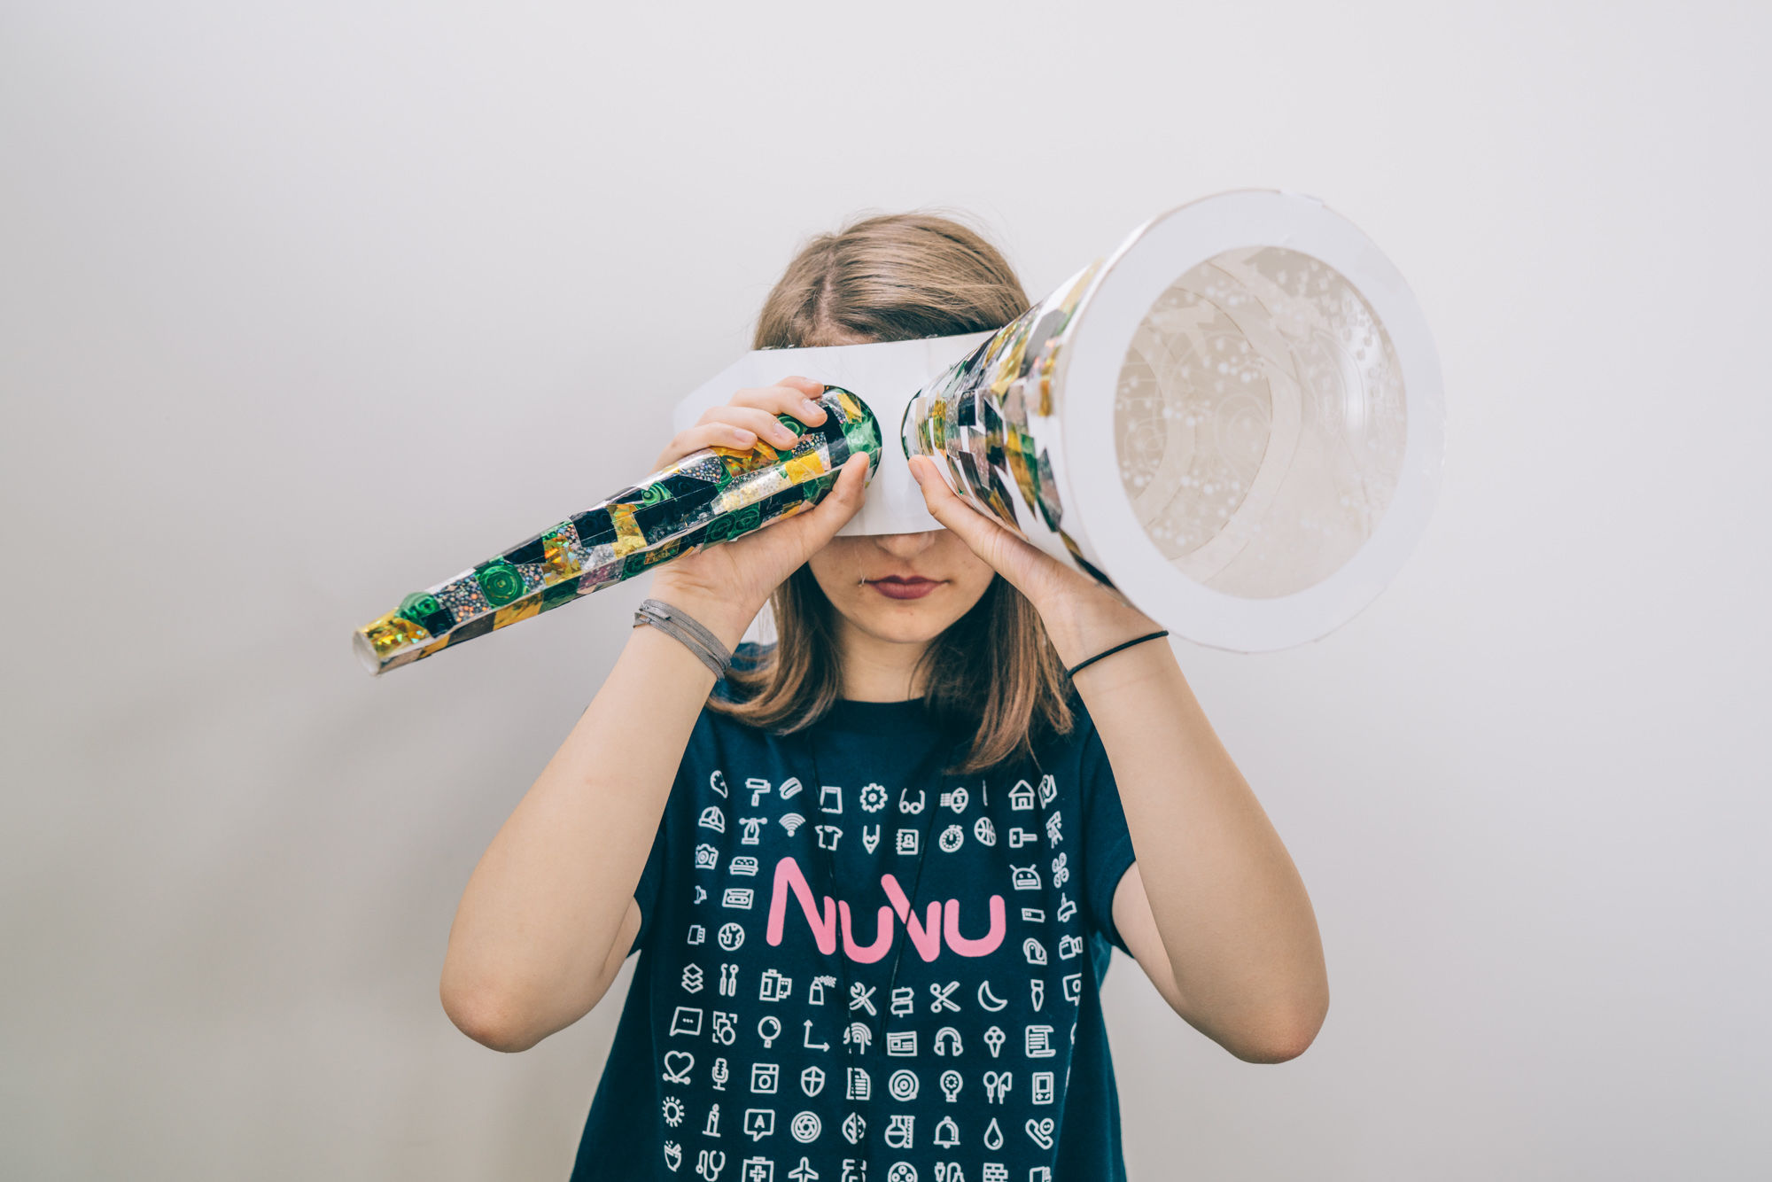
Bio Fashion: technology + place NuVu, 2017

Slide 39
Starting point:
Exploring local gardens

Slide 40
Developing ideas:

Slide 41
Students designed:

Slide 42
In this session we will prototype an interactive wearable device
Notes:
Afternoon challenge
--prototype: does not need to be finished or working you are creating something that will express and idea
--we have a bunch of materials for making sketches, you can also add the circuits you made earlier
--we will work together at the start to generate some ideas, and then you will work in your groups to develop one of your ideas
--the purpose it to communicate your idea with the group
–we will have short presentations at the end of the session, these will be informal, and there will be a bit of guidance on this later.

Slide 43
Activity quick thinking design challenge
Notes:
Area of interest i.e physical location, field you are interested in (not too obscure!)
Identify user group
3. Parts of the body 4. Emotion 5. Quality of Material (optional, may help with the design but can change) Quick thinking, make design, change.
Discussion Qs:
Did you go with a hunch (ideas you already had) or is this something new?
What was the most challenging part?

Slide 44
AREA OF BODY
Notes:
Do this in groups so that we have 4 of each 30 seconds of discussion time

Slide 45
AREA OF BODY
EXPERIENCE / INTEREST
Notes:
Something you do at the harbourside either with friends, family, school etc
i.e. getting the ferry

Slide 46
AREA OF BODY
EXPERIENCE / INTEREST
EMOTION
Notes:
Adjective –description of how people can feel

Slide 47
AREA OF BODY
EXPERIENCE / INTEREST
EMOTION
DEMOGRAPHIC
Notes:
I.e. young people, older people, families
WORKING INDIVIDUALLY
Everyone does all 4 on big sheet of paper with pens

Slide 48
Activity 2: build circuits test materials sewing demo
Notes:
Circuit building: What is a circuit Actuators and sensors (Bare minimum) Material and example showcase.

Slide 49
Programmers (which ones to choose?!)
Notes:
Other Technology that is available
Smart Materials combined with processing
–developments in microcontrollers like these to connect to materials
-main contenders = adafruit and lilypad both are arduino compatible
-SENSORS (on right –lilypad)

Slide 51
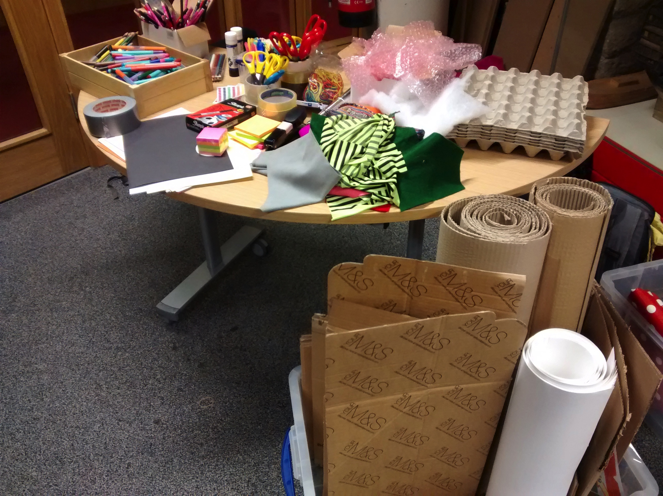
Where to buy these materials? Europe Kitronic Plug and Wear US Sparkfun Adafruit LessEMF –conductive fabrics Jameco –conductive thead And amazon / ebay often have a lot of materials for less$!

Slide 52
Links for making ideas
How to get what you want | http://www.kobakant.at/DIY
Conductive pom poms | http://www.instructables.com/id/Laser-Cut-Pom-Pom-Pressure-Sensors/
MIT high low tech | http://highlowtech.org/
What is an Arduino? | https://www.youtube.com/watch?v=pnf8ojsK6S4&feature=youtu.be
Makey Makey inspiration | https://docs.google.com/document/d/1_V5jCHmcdvQTC45uTBJtKna1rA9s2FYfT9zqgB_draY
Paper Circuit Materials list | https://docs.google.com/document/d/1FG8gmPqF3NS_vVanF4wa2y3CKUjLLqvlcKYemzPagnA/edit?usp=sharing
Sparkfun guide to paper circuits | https://learn.sparkfun.com/tutorials/the-great-big-guide-to-paper-circuits
Laser loom | http://www.thingiverse.com/thing:120555

Slide 53
Thank you! BECCA ROSE GLOWACKI twitter: @beccaerose website: www.beccarose.co.uk
Notes:
Interactive fashion accessories
Aim of this slide show is to give a bit of background, some context of what people are doing, and some inspiration for future development –made by you!

